Slide 1
Mapping data transitions
From data to sensemaking in learning analytics
Ben Hicks

Slide 2
Uh…what? Why?
Viewing an ‘analysis’ as a process of mappings between spaces (examples later)
Aim to make the analysis process, and conclusions, more accountable

Slide 3
Motivation & Me
The analytics to practitioner gap
The seduction of a simple answer in (educational data) analysis
The underlying complexity learning - cognitive, social, emotional, etc (Davis & Sumara, 2009)
Abstract mathematical tools / concepts to provide ‘rigor’ / frameworks

Slide 4
Previous work
Information flow (Barwise & Seligman)
Quotient spaces (Zhang & Zhang)
But none on the accountability of an analysis process or on learning analytics

Slide 5
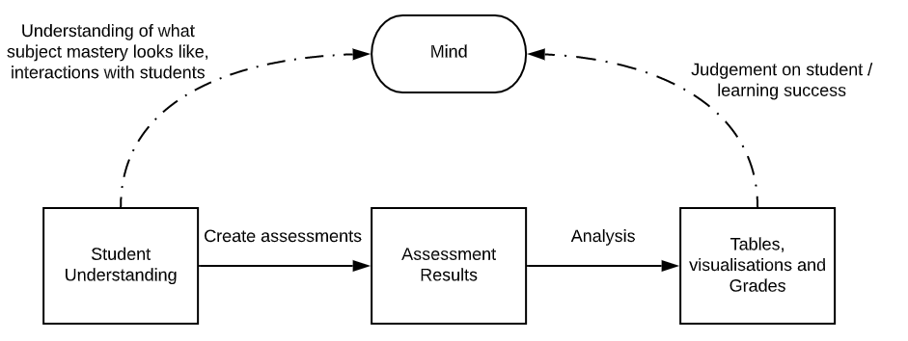
Example 1 - Understanding

Slide 6
Example 1 - Understanding

Slide 7
Example 1 - Understanding

Slide 8
Example 1 - Understanding
Most work on validation / accountability done here

Slide 9
Example 1 - Understanding

Slide 10
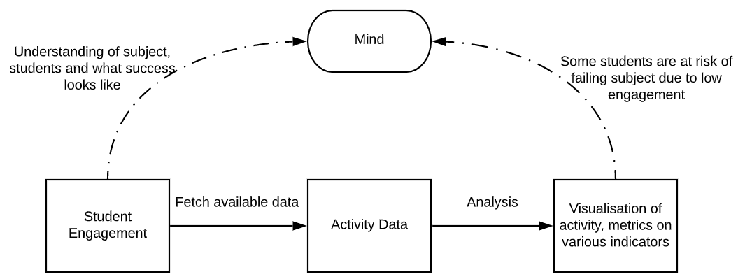
Example 2 - Engagement

Slide 11
Example 2 - Engagement

Slide 12
Example 2 - Engagement

Slide 13
Example 2 - Engagement

Slide 14
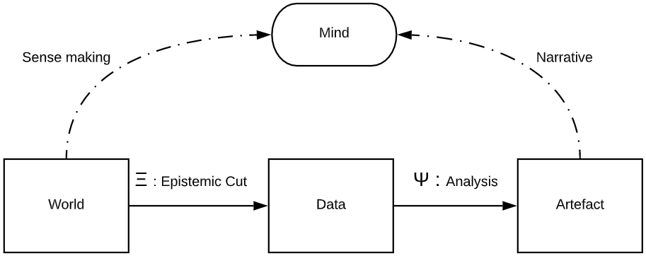
Mapping data transitions

Slide 15
Warning: Mathematics about to start
Abstract (and hopefully generalizable)
Categories (objects and arrows)
Spaces (Topologies as structure)

Slide 16
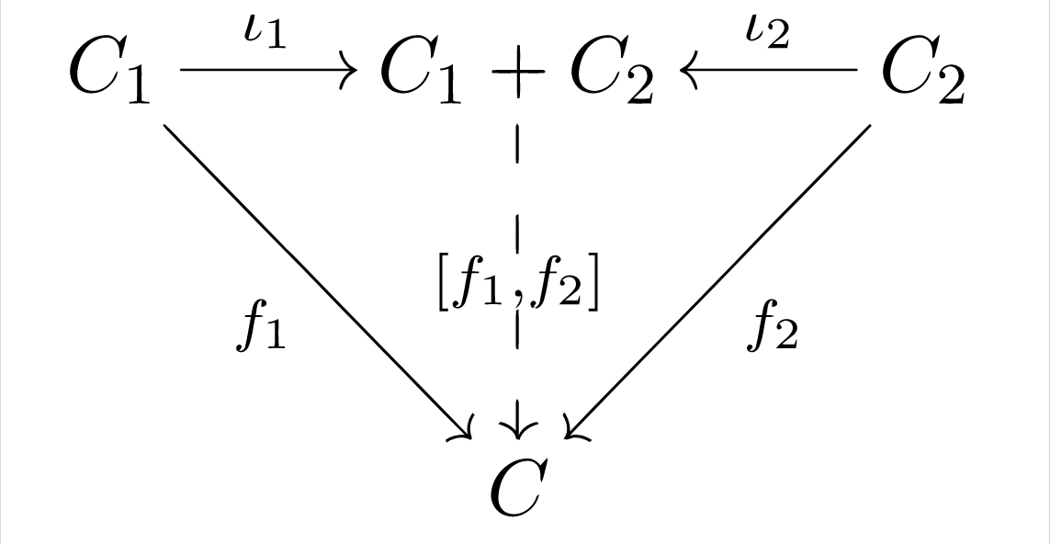
Category Theory
Category Theory is the language of objects and arrows
Very general, abstract to the point of some derision by the mathematical community
Emphasis on relationships over objects
Only recently “applied”

Slide 17
Spaces
Vector space (points, direction, location, distance)
Metric space (points, distance)
Topological space (points, neighbourhood)
Set (points)

Slide 18
Topological spaces to describe ‘structure’
A topology (i.e. a collection of neighbourhoods) on a set of points is a way of giving a minimal structure to the space
Used by Zhang & Zhang to for their Quotient Space Based Problem Solving framework
A similar notion is used by Bairwise & Seligmen in their Information Flow framework, but is less explicitly topologies

Slide 19
Mapping data transitions

